Slide 1
Python

Slide 2
Introduction
Most recent popular (scripting/extension) language
  although origin ~1991
heritage: teaching language (ABC)
  Tcl: shell
  perl: string (regex) processing
object-oriented
  rather than add-on (OOTcl)

Slide 3
Python philosophy
Coherence
  not hard to read, write and maintain
power
scope
  rapid development + large systems
objects
integration
  hybrid systems

Slide 4
Python features
Lutz, Programming Python
no compiling or linking | rapid development cycle
no type declarations | simpler, shorter, more flexible
automatic memory management | garbage collection
high-level data types and operations | fast development
object-oriented programming | code structuring and reuse, C++
embedding and extending in C | mixed language systems
classes, modules, exceptions | "programming-in-the-large" support
dynamic loading of C modules | simplified extensions, smaller binaries
dynamic reloading of C modules | programs can be modified without stopping

Slide 5
Python features
Lutz, Programming Python
universal "first-class" object model | fewer restrictions and rules
run-time program construction | handles unforeseen needs, end-user coding
interactive, dynamic nature | incremental development and testing
access to interpreter information | metaprogramming, introspective objects
wide portability | cross-platform programming without ports
compilation to portable byte-code | execution speed, protecting source code
built-in interfaces to external services | system tools, GUIs, persistence, databases, etc.

Slide 6
Python
elements from C++, Modula-3 (modules), ABC, Icon (slicing)
same family as Perl, Tcl, Scheme, REXX, BASIC dialects

Slide 7
Uses of Python
shell tools
  system admin tools, command line programs
extension-language work
rapid prototyping and development
language-based modules
  instead of special-purpose parsers
graphical user interfaces
database access
distributed programming
Internet scripting

Slide 8
What not to use Python (and kin) for
most scripting languages share these
not as efficient as C
  but sometimes better built-in algorithms (e.g., hashing and sorting)
delayed error notification
lack of profiling tools

Slide 9
Top 25 Python frameworks
Flask
Bottle
CherryPy
Django
FastAPI
Pyramid
Tornado
PyQt
Tkinter
Kivy
PySide
PySimpleGUI
scikit-learn
TensorFlow
PyTorch
Keras
NumPy
SciPy
Pandas
Matplotlib
Pytest
Unittest
nose2
asyncio
Aiohttp
St

Slide 10
Using python
/usr/local/bin/python
  #! /usr/bin/env python
interactive use
Python 1.6 (#1, Sep 24 2000, 20:40:45) [GCC 2.95.1 19990816 (release)] on sunos5
Copyright (c) 1995-2000 Corporation for National Research Initiatives.
All Rights Reserved.
Copyright (c) 1991-1995 Stichting Mathematisch Centrum, Amsterdam.
All Rights Reserved.
>>>
python –c command [arg] ...
python –i script
  read script first, then interactive
Advanced Programming
Spring 2002

Slide 11
Python structure
modules: Python source files or C extensions
  import, top-level via from, reload
statements
  control flow
  create objects
  indentation matters – instead of {}
objects
  everything is an object
  automatically reclaimed when no longer needed

Slide 12
First example
#!/usr/local/bin/python
# import systems module
import sys
marker = '::::::'
for name in sys.argv[1:]:
input = open(name, 'r')
print marker + name
print input.read()

Slide 13
Basic operations
Assignment:
  size = 40
  a = b = c = 3
Numbers
  integer, float
  complex numbers: 1j+3, abs(z)
Strings
  'hello world', 'it\'s hot'
  "bye world"
  continuation via \ or use """ long text """"

Slide 14
String operations
concatenate with + or neighbors
  word = 'Help' + x
  word = 'Help' 'a'
subscripting of strings
  'Hello'[2] → 'l'
  slice: 'Hello'[1:2] → 'el'
  word[-1] → last character
  len(word) → 5
  immutable: cannot assign to subscript

Slide 15
Lists
lists can be heterogeneous
  a = ['spam', 'eggs', 100, 1234, 2*2]
Lists can be indexed and sliced:
  a[0] → spam
  a[:2] → ['spam', 'eggs']
Lists can be manipulated
  a[2] = a[2] + 23
  a[0:2] = [1,12]
  a[0:0] = []
  len(a) → 5

Slide 16
Basic programming
a,b = 0, 1
# non-zero = true
while b < 10:
# formatted output, without \n
print b,
# multiple assignment
a,b = b, a+b

Slide 17
Control flow: if
x = int(raw_input("Please enter #:"))
if x < 0:
x = 0
print 'Negative changed to zero'
elif x == 0:
print 'Zero'
elif x == 1:
print 'Single'
else:
print 'More'
no case statement

Slide 18
Control flow: for
a = ['cat', 'window', 'defenestrate']
for x in a:
print x, len(x)
no arithmetic progression, but
  range(10) → [0, 1, 2, 3, 4, 5, 6, 7, 8, 9]
  for i in range(len(a)):
  print i, a[i]
do not modify the sequence being iterated over

Slide 19
Loops: break, continue, else
break and continue like C
else after loop exhaustion
for n in range(2,10):
for x in range(2,n):
if n % x == 0:
print n, 'equals', x, '*', n/x
break
else:
# loop fell through without finding a factor
print n, 'is prime'

Slide 20
Do nothing
pass does nothing
syntactic filler
while 1:
pass

Slide 21
Defining functions
def fib(n):
"""Print a Fibonacci series up to n."""
a, b = 0, 1
while b < n:
print b,
a, b = b, a+b
>>> fib(2000)
First line is docstring
first look for variables in local, then global
need global to assign global variables

Slide 22
Functions: default argument values
def ask_ok(prompt, retries=4, complaint='Yes or no, please!'):
while 1:
ok = raw_input(prompt)
if ok in ('y', 'ye', 'yes'): return 1
if ok in ('n', 'no'): return 0
retries = retries - 1
if retries < 0: raise IOError, 'refusenik error'
print complaint
>>> ask_ok('Really?')

Slide 23
Keyword arguments
last arguments can be given as keywords
def parrot(voltage, state='a stiff', action='voom', type='Norwegian blue'):
print "-- This parrot wouldn't", action,
print "if you put", voltage, "Volts through it."
print "Lovely plumage, the ", type
print "-- It's", state, "!"
parrot(1000)
parrot(action='VOOOM', voltage=100000)

Slide 24
Lambda forms
anonymous functions
may not work in older versions
  def make_incrementor(n):
  return lambda x: x + n
  f = make_incrementor(42)
  f(0)
  f(1)

Slide 25
List methods
append(x)
extend(L)
  append all items in list (like Tcl lappend)
insert(i,x)
remove(x)
pop([i]), pop()
  create stack (FIFO), or queue (LIFO) → pop(0)
index(x)
  return the index for value x

Slide 26
List methods
count(x)
  how many times x appears in list
sort()
  sort items in place
reverse()
  reverse list

Slide 27
Functional programming tools
filter(function, sequence)
  def f(x): return x%2 != 0 and x%3 0
  filter(f, range(2,25))
map(function, sequence)
  call function for each item
  return list of return values
reduce(function, sequence)
  return a single value
  call binary function on the first two items
  then on the result and next item
  iterate

Slide 28
List comprehensions (2.0)
Create lists without map(), filter(), lambda
= expression followed by for clause + zero or more for or of clauses
>>> vec = [2,4,6]
>>> [3*x for x in vec]
[6, 12, 18]
>>> [{x: x**2} for x in vec}
[{2: 4}, {4: 16}, {6: 36}]

Slide 29
List comprehensions
cross products:
>>> vec1 = [2,4,6]
>>> vec2 = [4,3,-9]
>>> [x*y for x in vec1 for y in vec2]
[8,6,-18, 16,12,-36, 24,18,-54]
>>> [x+y for x in vec1 and y in vec2]
[6,5,-7,8,7,-5,10,9,-3]
>>> [vec1[i]*vec2[i] for i in range(len(vec1))]
[8,12,-54]

Slide 30
List comprehensions
can also use if:
>>> [3*x for x in vec if x > 3]
[12, 18]
>>> [3*x for x in vec if x < 2]
[]

Slide 31
del – removing list items
remove by index, not value
remove slices from list (rather than by assigning an empty list)
>>> a = [-1,1,66.6,333,333,1234.5]
>>> del a[0]
>>> a
[1,66.6,333,333,1234.5]
>>> del a[2:4]
>>> a
[1,66.6,1234.5]

Slide 32
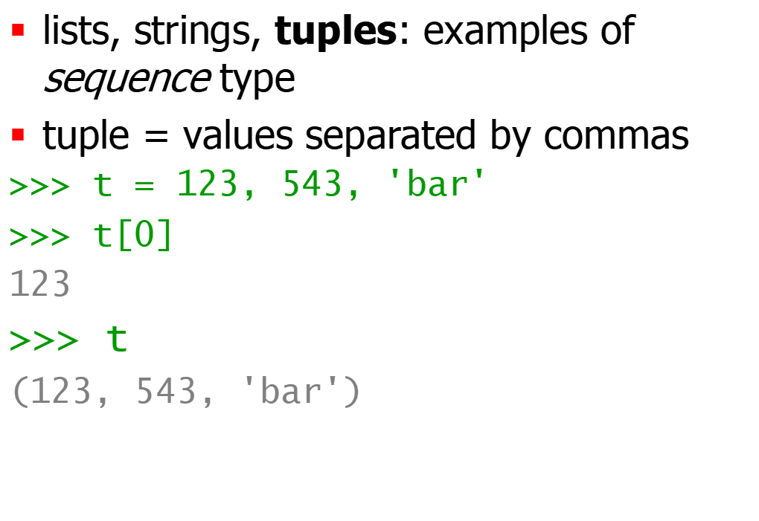
Tuples and sequences
Advanced Programming
Spring 2002

Slide 33
Tuples
Tuples may be nested
>>> u = t, (1,2)
>>> u
((123, 542, 'bar'), (1,2))
kind of like structs, but no element names:
  (x,y) coordinates
  database records
like strings, immutable → can't assign to individual items

Slide 34
Tuples
Empty tuples: ()
>>> empty = ()
>>> len(empty)
0
one item → trailing comma
>>> singleton = 'foo',

Slide 35
Tuples
sequence unpacking → distribute elements across variables
>>> t = 123, 543, 'bar'
>>> x, y, z = t
>>> x
123
packing always creates tuple
unpacking works for any sequence

Slide 36
Dictionaries
like Tcl or awk associative arrays
indexed by keys
keys are any immutable type: e.g., tuples
but not lists (mutable!)
uses 'key: value' notation
>>> tel = {'hgs' : 7042, 'lennox': 7018}
>>> tel['cs'] = 7000
>>> tel

Slide 37
Dictionaries
no particular order
delete elements with del
>>> del tel['foo']
keys() method → unsorted list of keys
>>> tel.keys()
['cs', 'lennox', 'hgs']
use has_key() to check for existence
>>> tel.has_key('foo')
0

Slide 38
Conditions
can check for sequence membership with is and is not:
  >>> if (4 in vec):
  ... print '4 is'
chained comparisons: a less than b AND b equals c:
  a < b == c
and and or are short-circuit operators:
  evaluated from left to right
  stop evaluation as soon as outcome clear

Slide 39
Conditions
Can assign comparison to variable:
  >>> s1,s2,s3='', 'foo', 'bar'
  >>> non_null = s1 or s2 or s3
  >>> non_null
  foo
Unlike C, no assignment within expression

Slide 40
Comparing sequences
unlike C, can compare sequences (lists, tuples, ...)
lexicographical comparison:
  compare first; if different → outcome
  continue recursively
  subsequences are smaller
  strings use ASCII comparison
  can compare objects of different type, but by type name (list < string < tuple)

Slide 41
Comparing sequences
(1,2,3) < (1,2,4)
[1,2,3] < [1,2,4]
'ABC' < 'C' < 'Pascal' < 'Python'
(1,2,3) == (1.0,2.0,3.0)
(1,2) < (1,2,-1)

Slide 42
Modules
collection of functions and variables, typically in scripts
definitions can be imported
file name is module name + .py
e.g., create module fibo.py
def fib(n): # write Fib. series up to n
...
def fib2(n): # return Fib. series up to n

Slide 43
Modules
import module:
  import fibo
Use modules via "name space":
  >>> fibo.fib(1000)
  >>> fibo.__name__
  'fibo'
can give it a local name:
  >>> fib = fibo.fib
  >>> fib(500)

Slide 44
Modules
function definition + executable statements
executed only when module is imported
modules have private symbol tables
avoids name clash for global variables
accessible as module.globalname
can import into name space:
  >>> from fibo import fib, fib2
  >>> fib(500)
can import all names defined by module:
  >>> from fibo import *

Slide 45
Module search path
current directory
list of directories specified in PYTHONPATH environment variable
uses installation-default if not defined, e.g., .:/usr/local/lib/python
uses sys.path
  >>> import sys
  >>> sys.path
  ['', 'C:\\PROGRA~1\\Python2.2', 'C:\\Program Files\\Python2.2\\DLLs', 'C:\\Program Files\\Python2.2\\lib', 'C:\\Program Files\\Python2.2\\lib\\lib-tk', 'C:\\Program Files\\Python2.2', 'C:\\Program Files\\Python2.2\\lib\\site-packages']

Slide 46
Compiled Python files
include byte-compiled version of module if there exists fibo.pyc in same directory as fibo.py
only if creation time of fibo.pyc matches fibo.py
automatically write compiled file, if possible
platform independent
doesn't run any faster, but loads faster
can have only .pyc file → hide source

Slide 47
Standard modules
system-dependent list
always sys module
  >>> import sys
  >>> sys.p1
  '>>> '
  >>> sys.p2
  '... '
  >>> sys.path.append('/some/directory')

Slide 48
Module listing
use dir() for each module
  >>> dir(fibo)
  ['___name___', 'fib', 'fib2']
  >>> dir(sys)
  ['__displayhook__', '__doc__', '__excepthook__', '__name__', '__stderr__', '__st
  din__', '__stdout__', '_getframe', 'argv', 'builtin_module_names', 'byteorder',
  'copyright', 'displayhook', 'dllhandle', 'exc_info', 'exc_type', 'excepthook', '
  exec_prefix', 'executable', 'exit', 'getdefaultencoding', 'getrecursionlimit', '
  getrefcount', 'hexversion', 'last_type', 'last_value', 'maxint', 'maxunicode', '
  modules', 'path', 'platform', 'prefix', 'ps1', 'ps2', 'setcheckinterval', 'setpr
  ofile', 'setrecursionlimit', 'settrace', 'stderr', 'stdin', 'stdout', 'version',
  'version_info', 'warnoptions', 'winver']

Slide 49
Classes
mixture of C++ and Modula-3
multiple base classes
derived class can override any methods of its base class(es)
method can call the method of a base class with the same name
objects have private data
C++ terms:
  all class members are public
  all member functions are virtual
  no constructors or destructors (not needed)

Slide 50
Classes
classes (and data types) are objects
built-in types cannot be used as base classes by user
arithmetic operators, subscripting can be redefined for class instances (like C++, unlike Java)

Slide 51
Class definitions
Class ClassName:
<statement-1>
...
<statement-N>
must be executed
can be executed conditionally (see Tcl)
creates new namespace

Slide 52
Namespaces
mapping from name to object:
  built-in names (abs())
  global names in module
  local names in function invocation
attributes = any following a dot
  z.real, z.imag
attributes read-only or writable
  module attributes are writeable

Slide 53
Namespaces
scope = textual region of Python program where a namespace is directly accessible (without dot)
  innermost scope (first) = local names
  middle scope = current module's global names
  outermost scope (last) = built-in names
assignments always affect innermost scope
  don't copy, just create name bindings to objects
global indicates name is in global scope

Slide 54
Class objects
obj.name references (plus module!):
  class MyClass:
  "A simple example class"
  i = 123
  def f(self):
  return 'hello world'
  >>> MyClass.i
  123
MyClass.f is method object
Advanced Programming
Spring 2002

Slide 55
Class objects
class instantiation:
  >>> x = MyClass()
  >>> x.f()
  'hello world'
creates new instance of class
  note x = MyClass vs. x = MyClass()
___init__() special method for initialization of object
  def __init__(self,realpart,imagpart):
  self.r = realpart
  self.i = imagpart

Slide 56
Instance objects
attribute references
data attributes (C++/Java data members)
  created dynamically
  x.counter = 1
  while x.counter < 10:
  x.counter = x.counter * 2
  print x.counter
  del x.counter

Slide 57
Method objects
Called immediately:
  x.f()
can be referenced:
  xf = x.f
  while 1:
  print xf()
object is passed as first argument of function → 'self'
  x.f() is equivalent to MyClass.f(x)

Slide 58
Notes on classes
Data attributes override method attributes with the same name
no real hiding → not usable to implement pure abstract data types
clients (users) of an object can add data attributes
first argument of method usually called self
  'self' has no special meaning (cf. Java)

Slide 59
Another example
bag.py
  class Bag:
  def __init__(self):
  self.data = []
  def add(self, x):
  self.data.append(x)
  def addtwice(self,x):
  self.add(x)
  self.add(x)

Slide 60
Another example, cont'd.
invoke:
  >>> from bag import *
  >>> l = Bag()
  >>> l.add('first')
  >>> l.add('second')
  >>> l.data
  ['first', 'second']

Slide 61
Inheritance
class DerivedClassName(BaseClassName)
<statement-1>
...
<statement-N>
search class attribute, descending chain of base classes
may override methods in the base class
call directly via BaseClassName.method

Slide 62
Multiple inheritance
class DerivedClass(Base1,Base2,Base3):
<statement>
depth-first, left-to-right
problem: class derived from two classes with a common base class

Slide 63
Private variables
No real support, but textual replacement (name mangling)
__var is replaced by _classname_var
prevents only accidental modification, not true protection

Slide 64
~ C structs
Empty class definition:
  class Employee:
  pass
  john = Employee()
  john.name = 'John Doe'
  john.dept = 'CS'
  john.salary = 1000

Slide 65
Exceptions
syntax (parsing) errors
while 1 print 'Hello World'
File "<stdin>", line 1
while 1 print 'Hello World'
^
SyntaxError: invalid syntax
exceptions
  run-time errors
  e.g., ZeroDivisionError, NameError, TypeError

Slide 66
Handling exceptions
while 1:
try:
x = int(raw_input("Please enter a number: "))
break
except ValueError:
print "Not a valid number"
First, execute try clause
if no exception, skip except clause
if exception, skip rest of try clause and use except clause
if no matching exception, attempt outer try statement

Slide 67
Handling exceptions
try.py
import sys
for arg in sys.argv[1:]:
try:
f = open(arg, 'r')
except IOError:
print 'cannot open', arg
else:
print arg, 'lines:', len(f.readlines())
f.close
e.g., as python try.py *.py

Slide 68
Language comparison
 |  | Tcl | Perl | Python | JavaScript | Visual Basic
Speed | development | ✓ | ✓ | ✓ | ✓ | ✓
 | regexp | ✓ | ✓ | ✓
breadth | extensible | ✓ |  | ✓ |  | ✓
 | embeddable | ✓ |  | ✓
 | easy GUI | ✓ |  | ✓ (Tk) |  | ✓
 | net/web | ✓ | ✓ | ✓ | ✓ | ✓
enterprise | cross-platform | ✓ | ✓ | ✓ | ✓
 | I18N | ✓ |  | ✓ | ✓ | ✓
 | thread-safe | ✓ |  | ✓ |  | ✓
 | database access | ✓ | ✓ | ✓ | ✓ | ✓

